Slide 1
East Finchley Controlled Parking Zone 11th April 2024
https://www.eastfinchley.london/

Slide 2
East Finchley Town Team – Who are we?

Slide 3
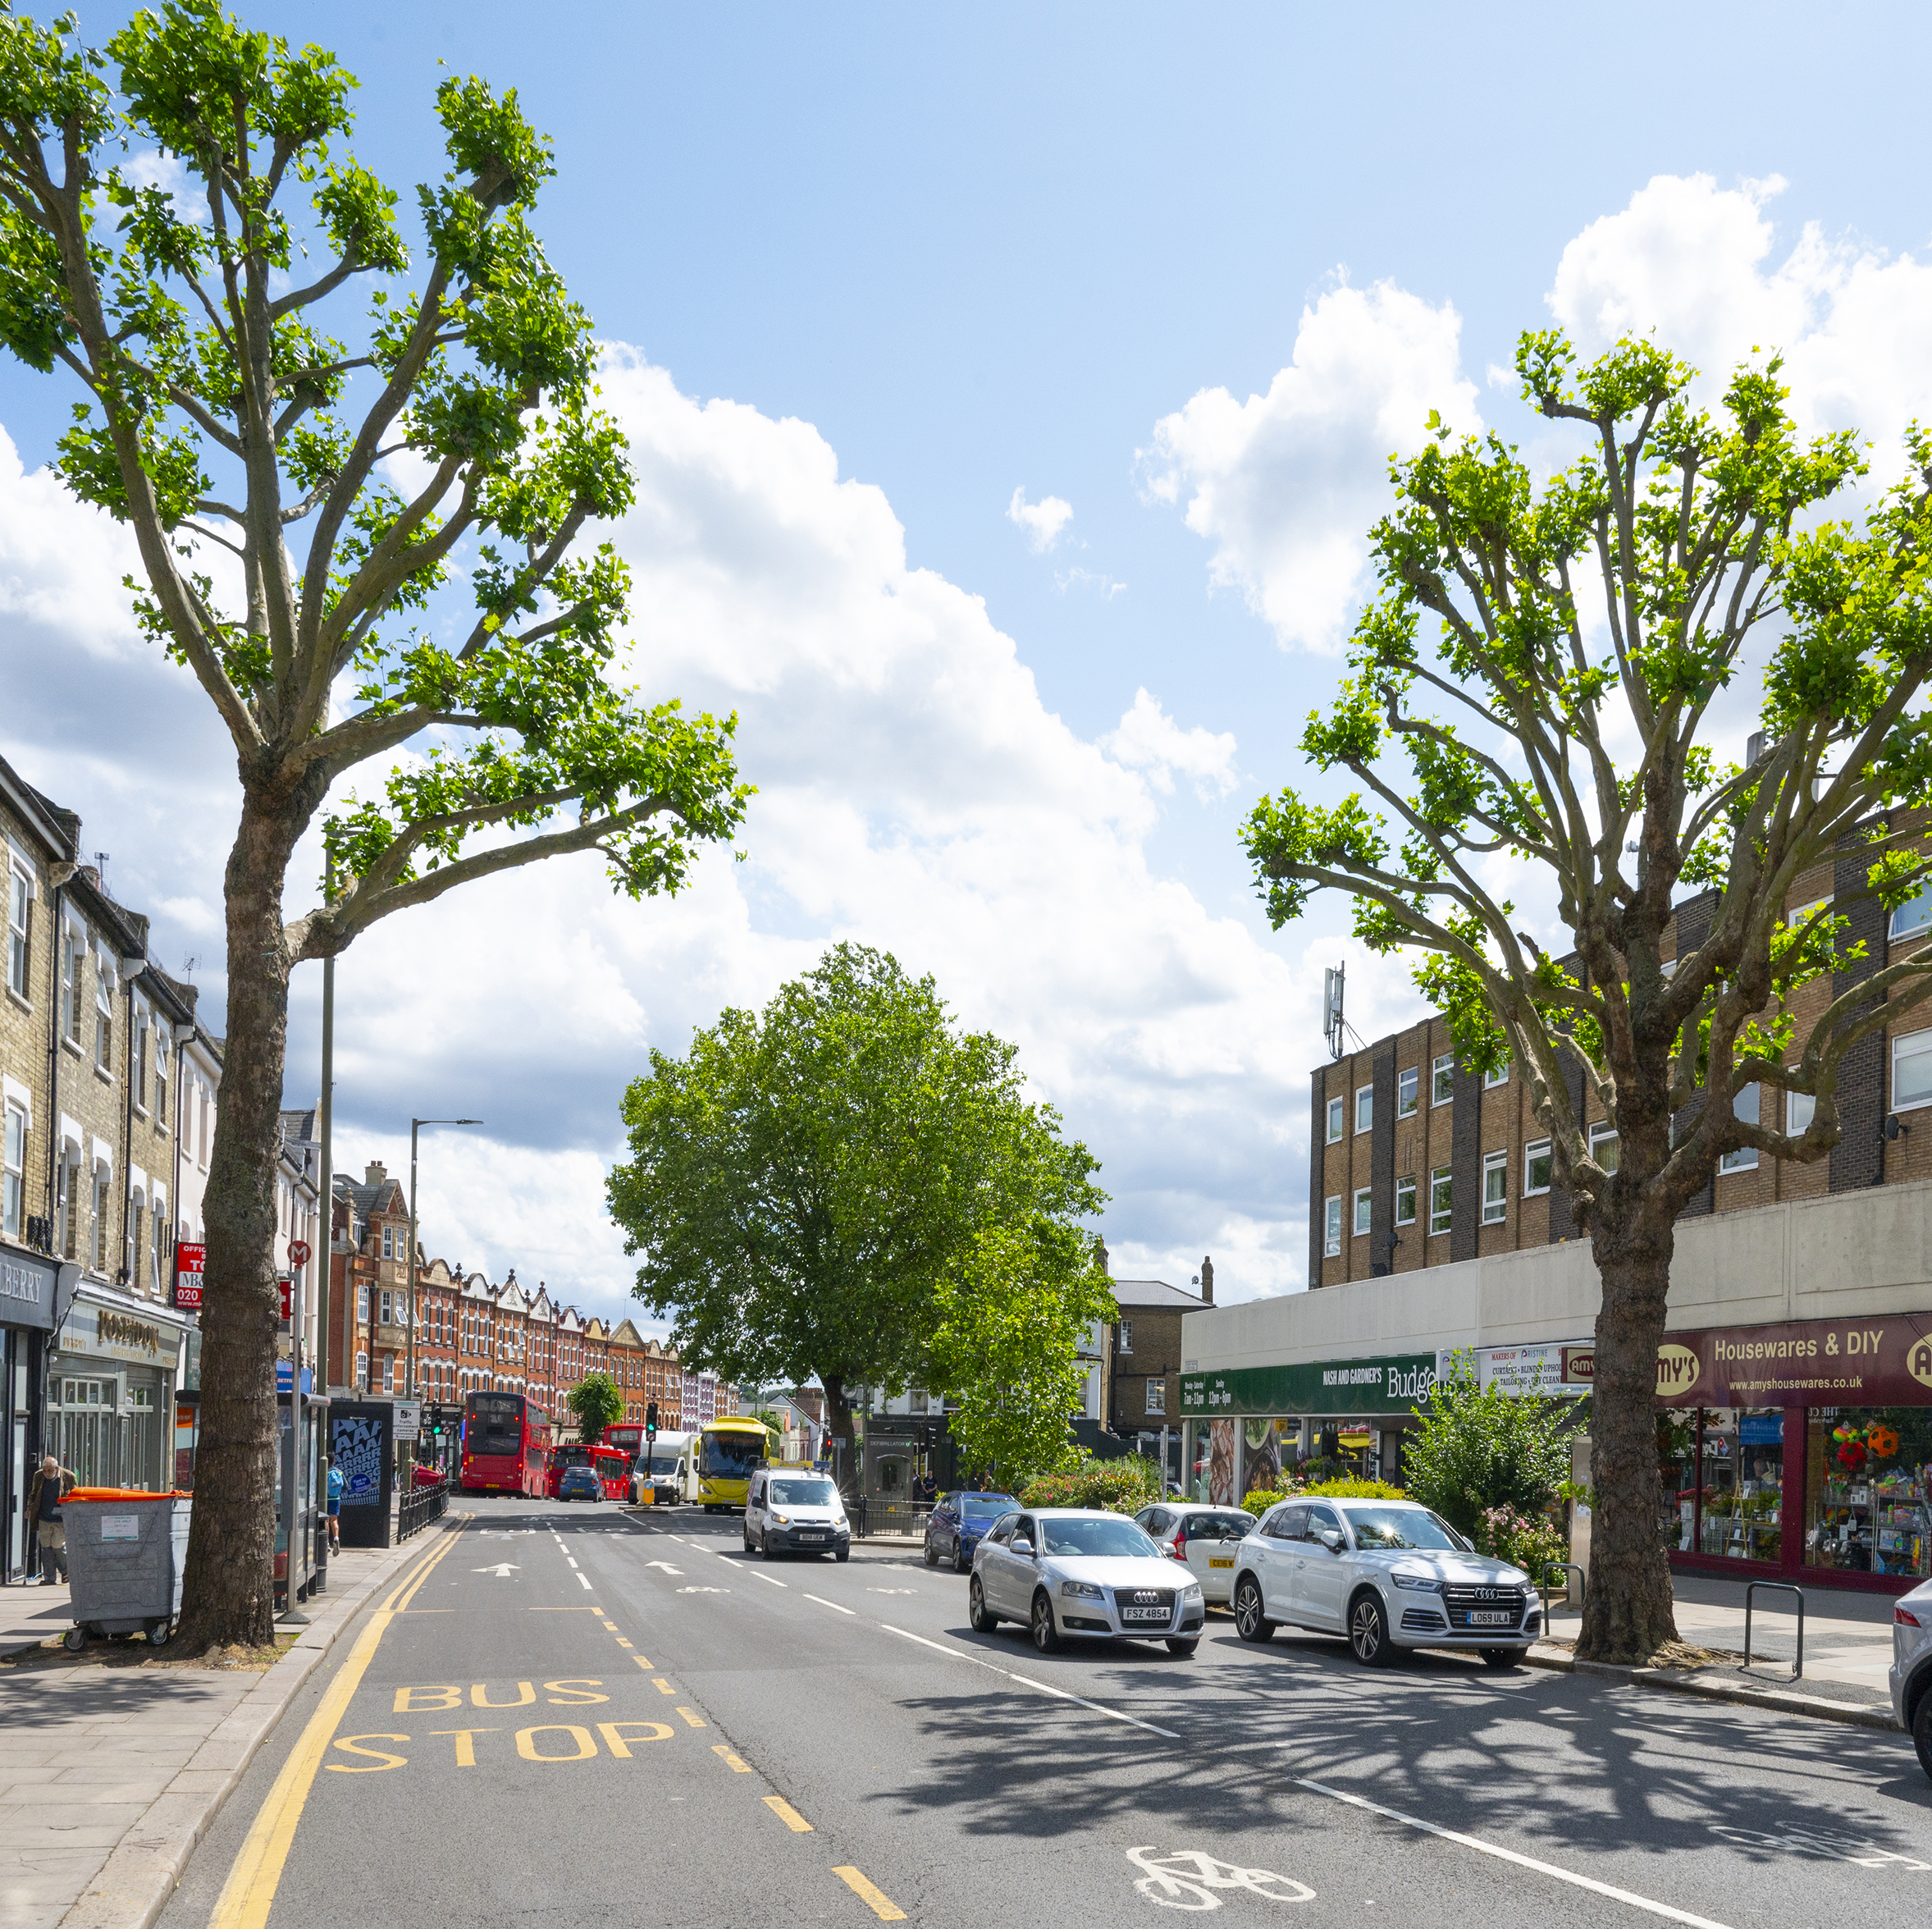
East Finchley Controlled Parking Zone Impact
Residents
Traders and Business on High Road
Organisations e.g. Schools, youth Theatre, Community Centres etc.
Visitors to East Finchley

Slide 4
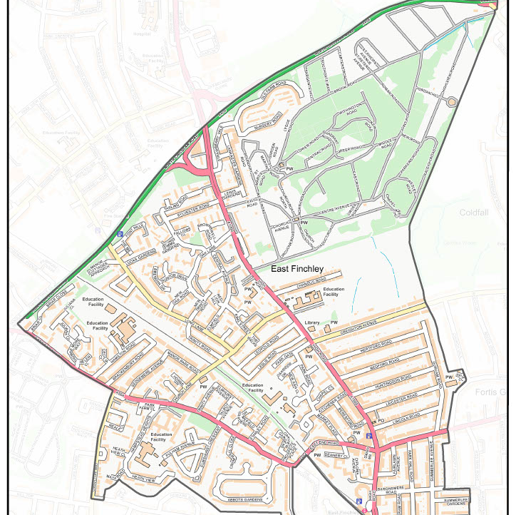
Current CPZ restrictions
East Finchley (M): Monday to Friday 2 – 3pm
Leslie Road/Leopold Road (LL) Monday to Friday 2 – 3pm
East Finchley M1: Monday to Saturday 10am – 6.30pm

Slide 5
Why was the new CPZ proposed?
According to the Council report:
“These issues are specific to your area:
Commuter parking and access problems on the Thomas More estate, particularly during weekends
Parking issues in King Street, Church Lane, Elmfield Road, Long Lane and Creighton Avenue
A petition received from residents of Chandos Road requesting CPZ controls
Request for parking short term parking for people visiting shops and local businesses
Loading facilities requested to support the operations of local businesses
Displaced parking from the recently introduced or amended CPZs
Motorists parking at junctions causing safety issues for road users”
https://pclengagement-hub.co.uk/en-GB/projects/eastfinchleyparking

Slide 6
Timeline
Consultation
Engagement results
22% wanted controls
71% didn’t
7% unsure
But …
Of those who didn’t want controls 29% experienced issues “and it was felt … would benefit from parking controls.”
January 2021 – Barnet Council Environment Committee agree borough wide programme of parking controls – “to review and address a backlog of requests for parking controls…”
1st December 2021 – 12th January 2022 “Informal engagement” 3000 properties leafleted across East Finchley.
1771 visitors viewed engagement website
30 email enquiries
434 unique responses – 376 from addresses on Council owned roads = 14% response rate.

Slide 7
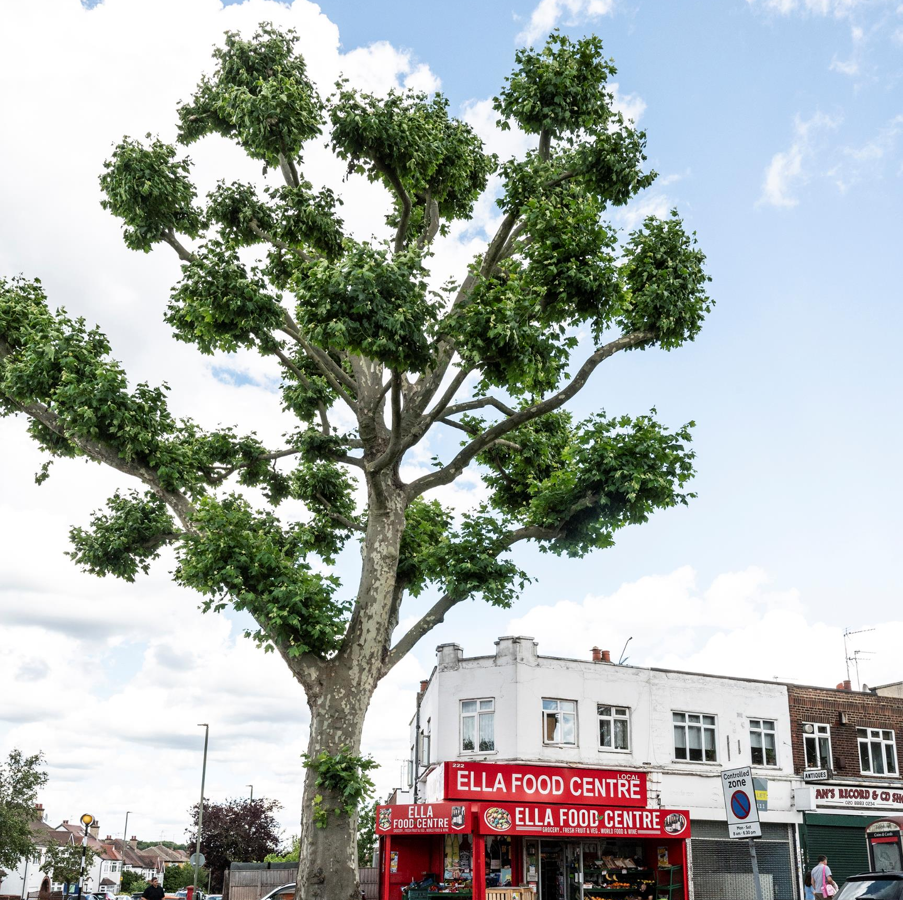
Important Information - East Finchley (EF) CPZ “Please note that the implementation of the experimental zone (EF) CPZ has been paused. Residents will be advised of the date that permit sales open in advance of the rescheduled implementation date.”

Slide 8
What do we want ….
If there is a need for more East Finchley CPZs full and proper consultation
Work co-operatively with local community on any future CPZ consultations and proposals
Use existing community networks e.g Archer Newspaper and local social media in addition to normal council approaches to consultation
Full impact of any CPZ on traders, businesses, community organisations and schools to be assessed
No increase in operating hours of existing East Finchley CPZs immediately adjacent to High Road

Slide 9
What do you want?
https://www.eastfinchley.london/

